Slide 1

Revealing
Roc
CS298 - Embedded Systems
Fall 2018
Malik Roc

Slide 2
Story
Roc holds many valuable secrets. However, to know such secret you must win a game of Revealing Roc!

Slide 3

Objective
Traverse through the board to reveal Roc’s secret
The player has 3 chances to find the Roc Bulb 3 times.

Slide 4
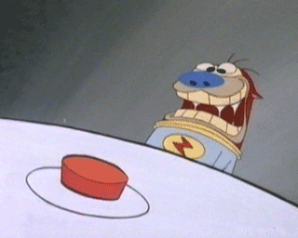
Controls
Use the 2-Axis Joystick to move throughout the board
Use the button to check whether or not the Roc Bulb is in the indicated position
Notes:
https://media1.tenor.com/images/615f068eb84dd8d8d794797ef8bd67ec/tenor.gif?itemid=3894001

Slide 5

Controls
The Roc Bulb is set in a random position at the beginning of the game
The Roc Bulb’s position changes when the player guesses it’s position correctly
Start here
Notes:
https://media1.tenor.com/images/615f068eb84dd8d8d794797ef8bd67ec/tenor.gif?itemid=3894001

Slide 6
Controls
Player loses a life if the guess is wrong
Player gains a point if the guess is right
Game is over once all lives are lost
Player wins the game once they obtain three points
Life
Points
Notes:
https://media1.tenor.com/images/615f068eb84dd8d8d794797ef8bd67ec/tenor.gif?itemid=3894001

Slide 7


Unlocking Roc’s Secret
When the player obtains three points, a series of characters will appear on the seven segment display
Can you unlock it’s secret?
Points
Notes:
https://media1.tenor.com/images/615f068eb84dd8d8d794797ef8bd67ec/tenor.gif?itemid=3894001

Slide 8
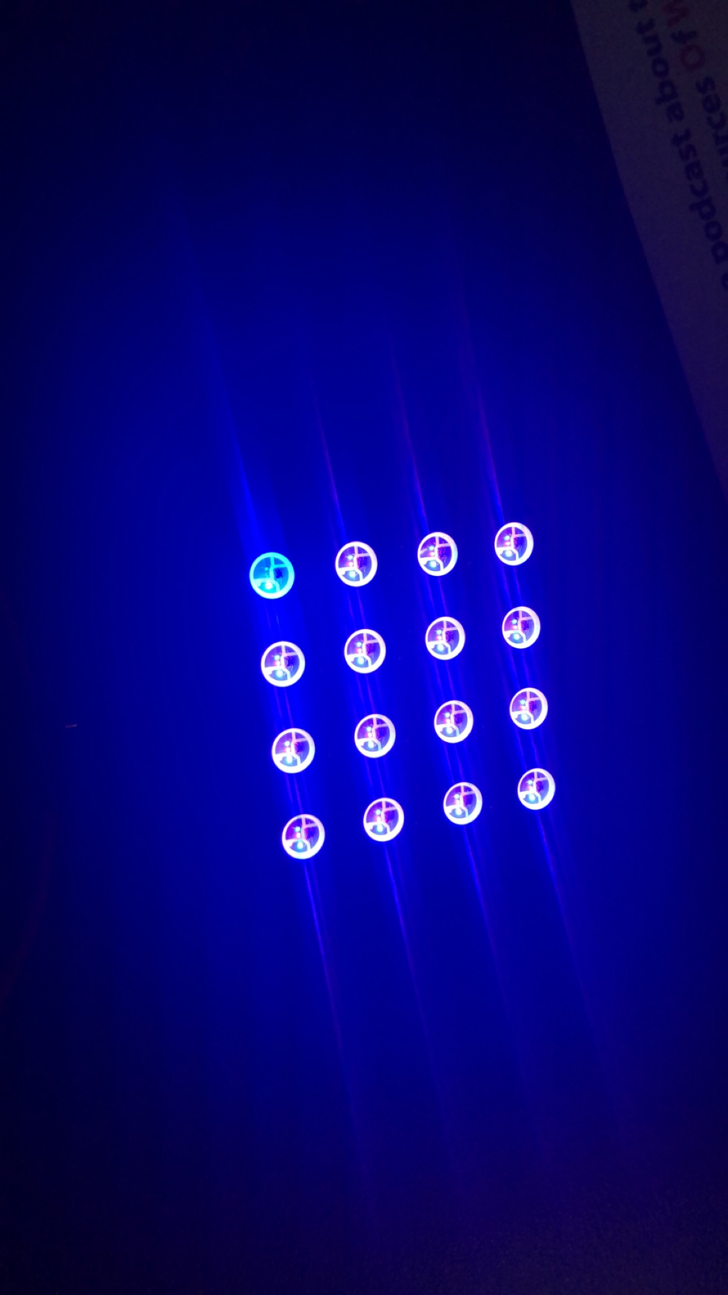
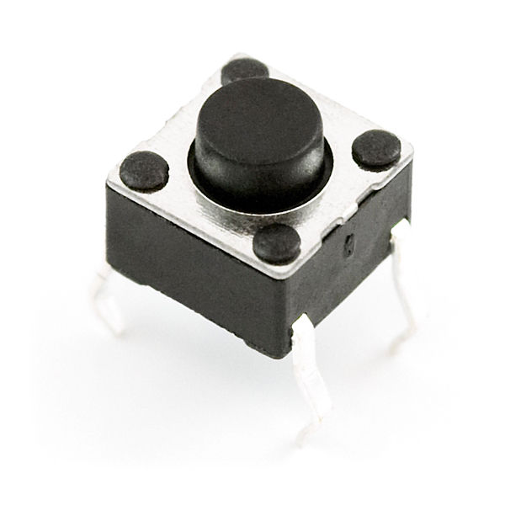
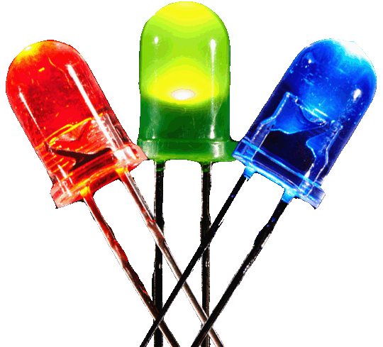
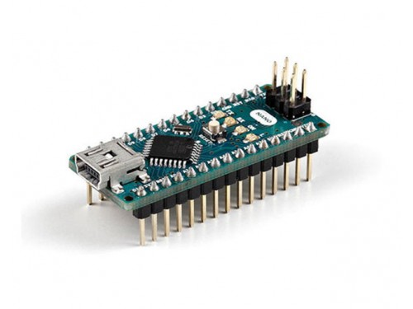
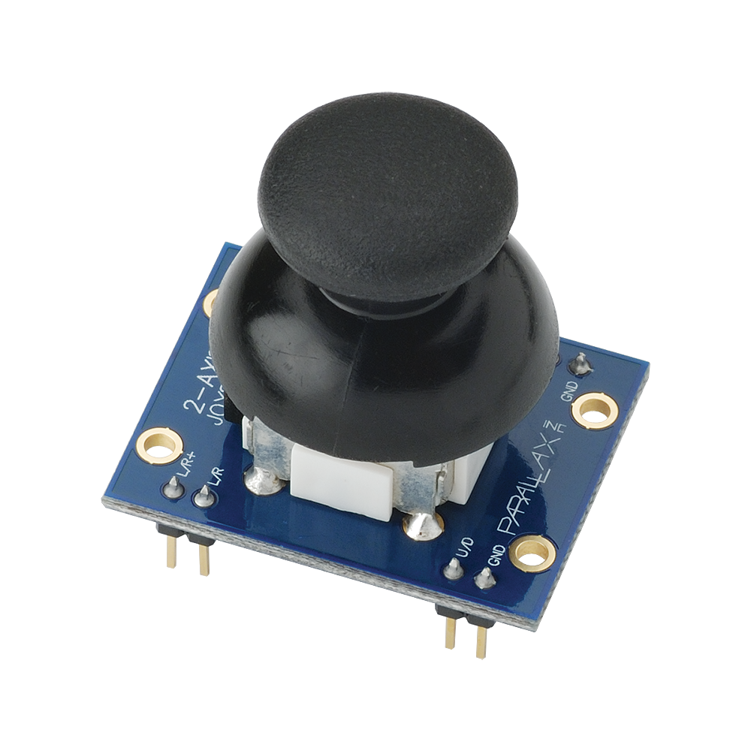
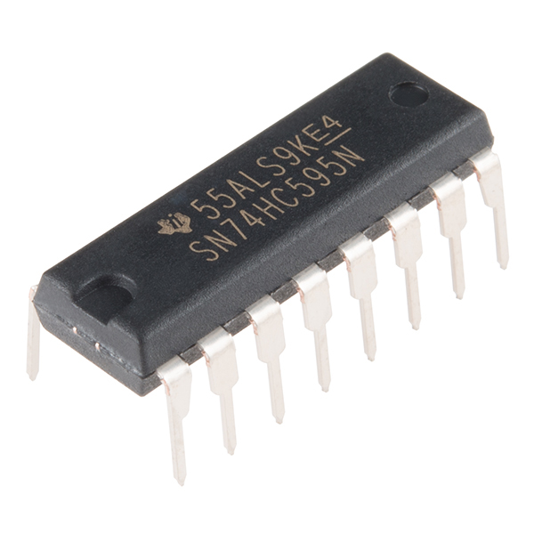
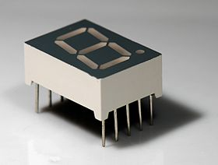
Hardware
6x LEDs
3 red
3 green
1x 4x4 WS2812B LED Matrix
1x Switch
1x 2-axis Joystick
1x Seven-segment display
1x 74HC595 shift bit register
1x Arduino nano

Slide 9
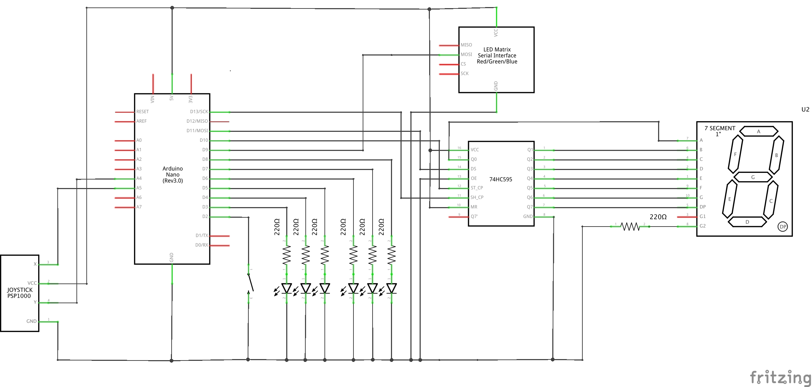
Hardware

Slide 10

Software
Simulates the LED Matrix
Maintains the following:
Position of target
Position of player
Number of lives
Number of points
Rev
Roc
Maps out the LED Matrix’s lights for the player to traverse through the board
Library

Slide 11

Software
Obtains the direction in which the player wants to move
Listens for the user to press the guess button
Displays the player’s current position throughout the game
Utilizes the LEDs to notify the player of their lives and points
Sketch

Slide 12




Challenges
Displaying the background, target, and player on the LED Matrix
Finding the appropriate colors to display on the LED Matrix
Design of the sketch and library

Slide 13
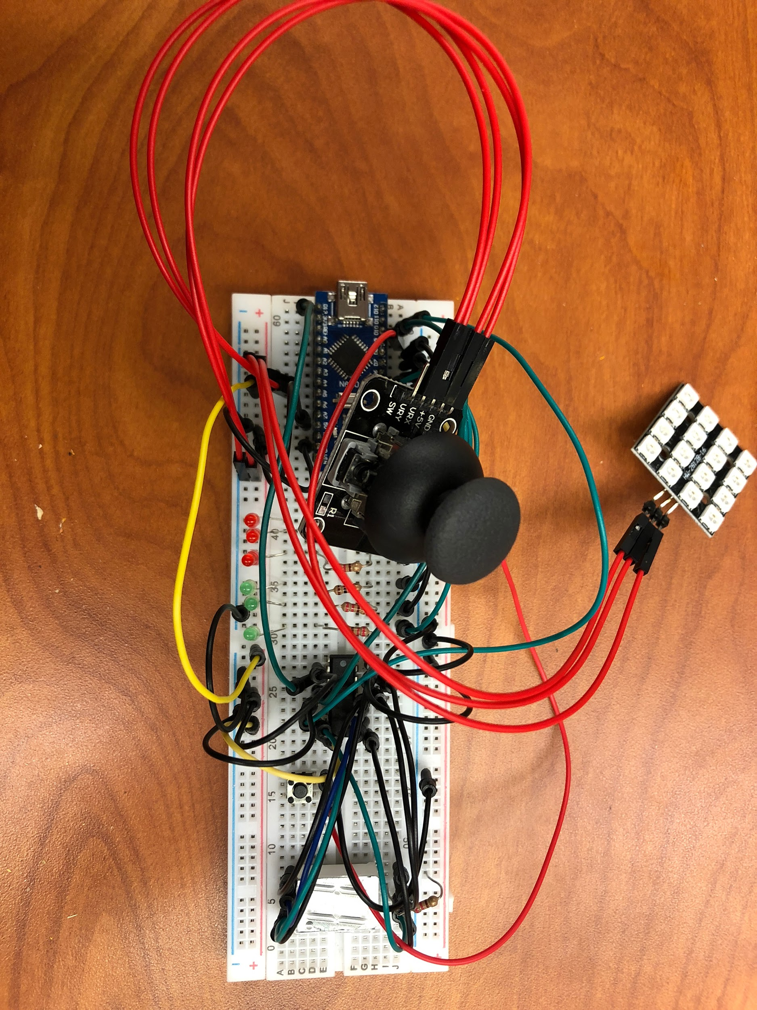
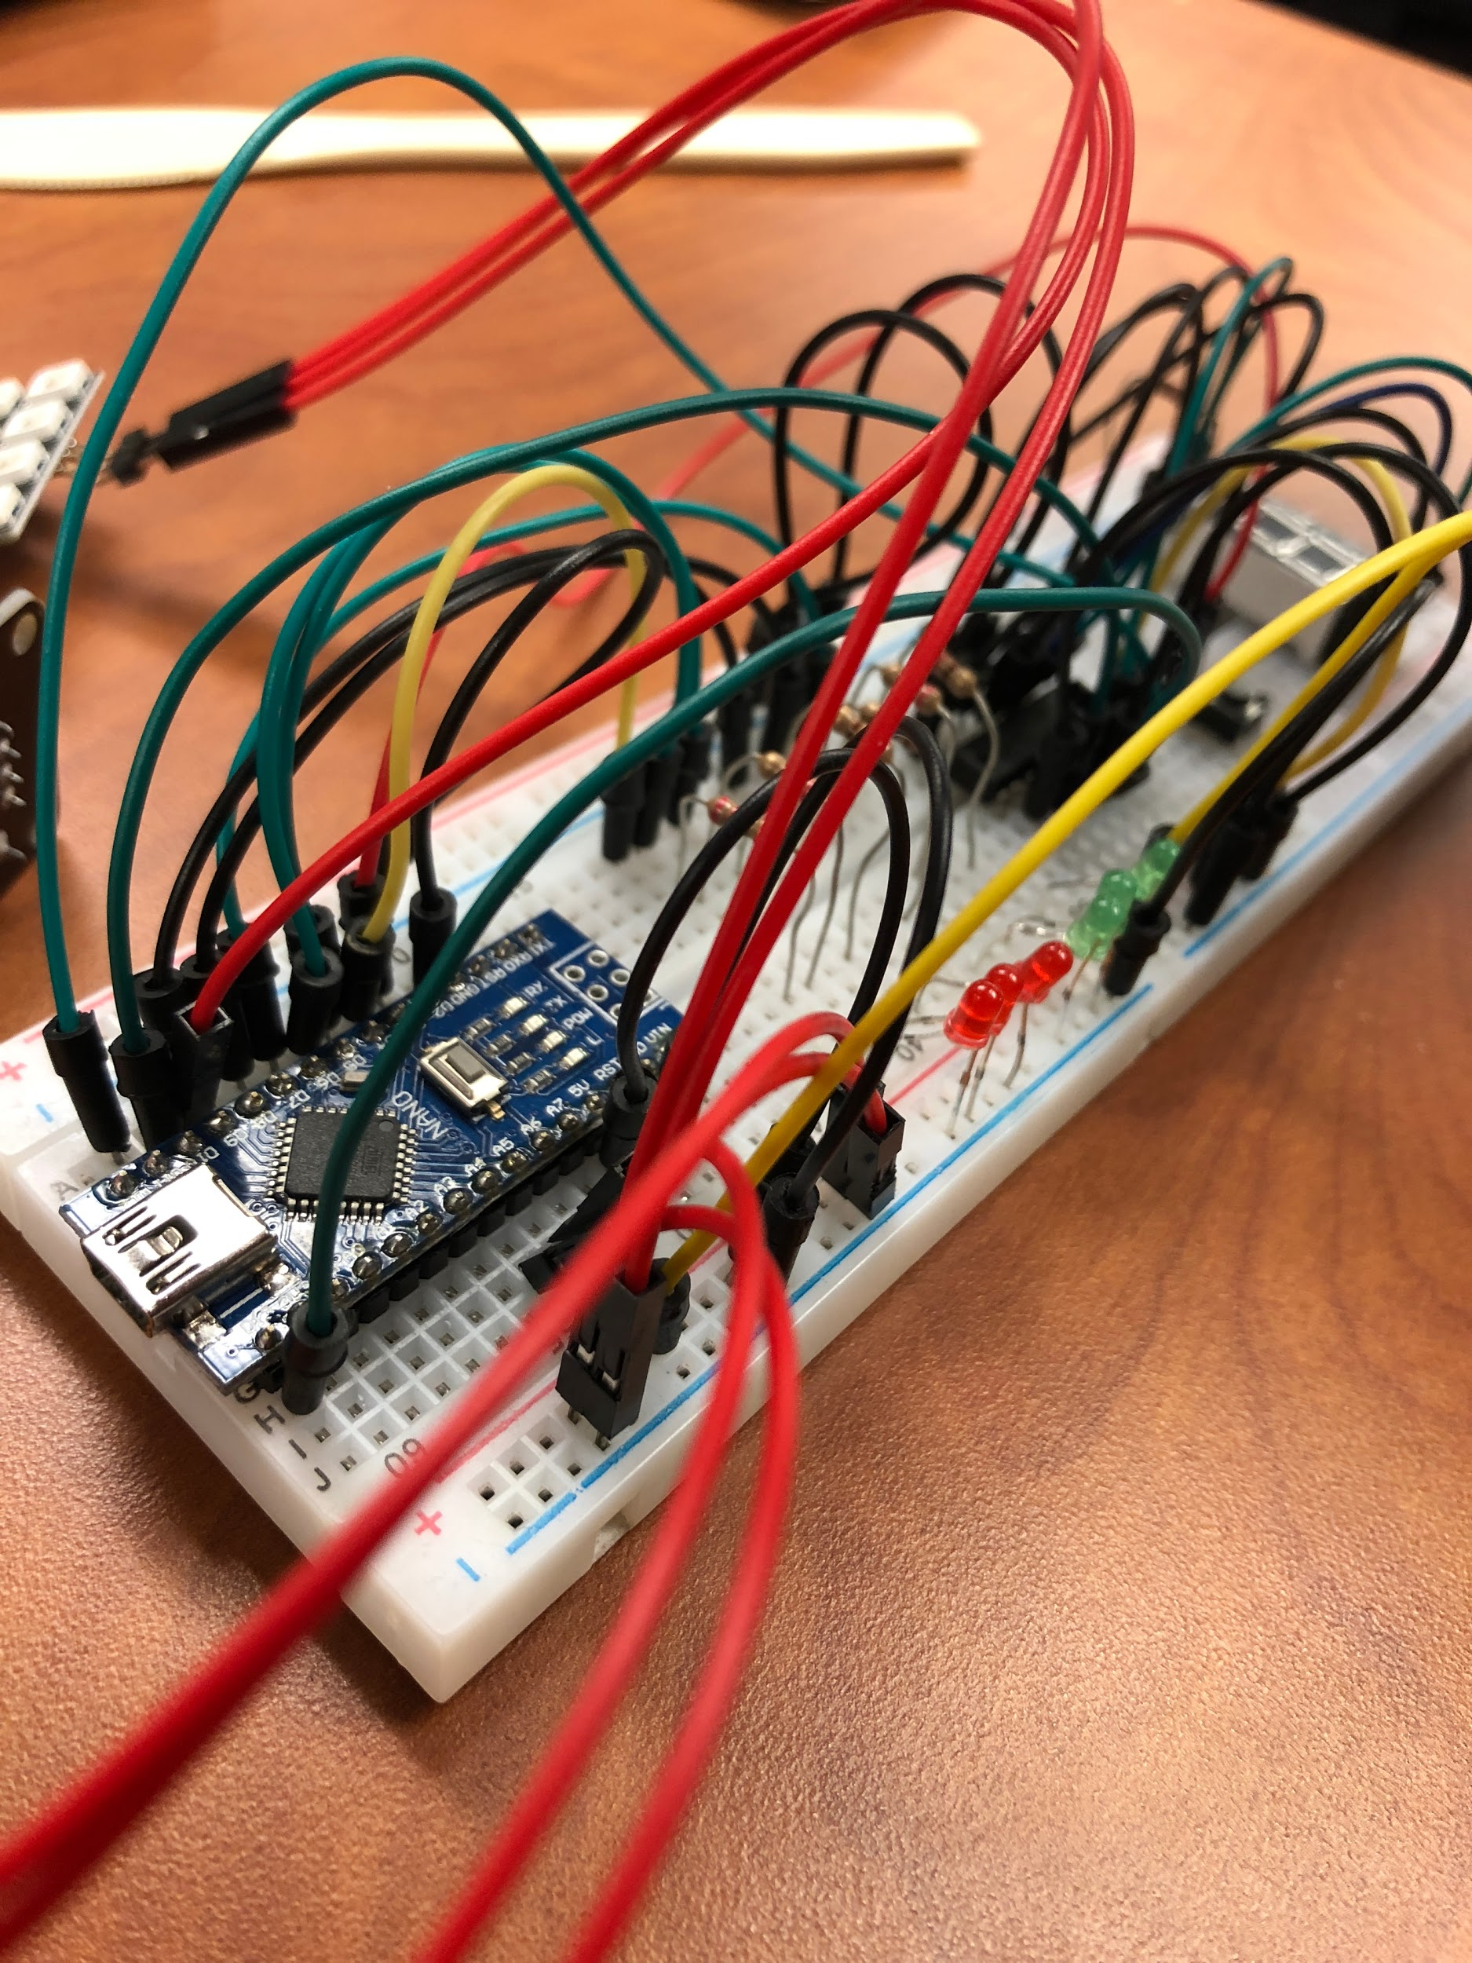

Slide 14
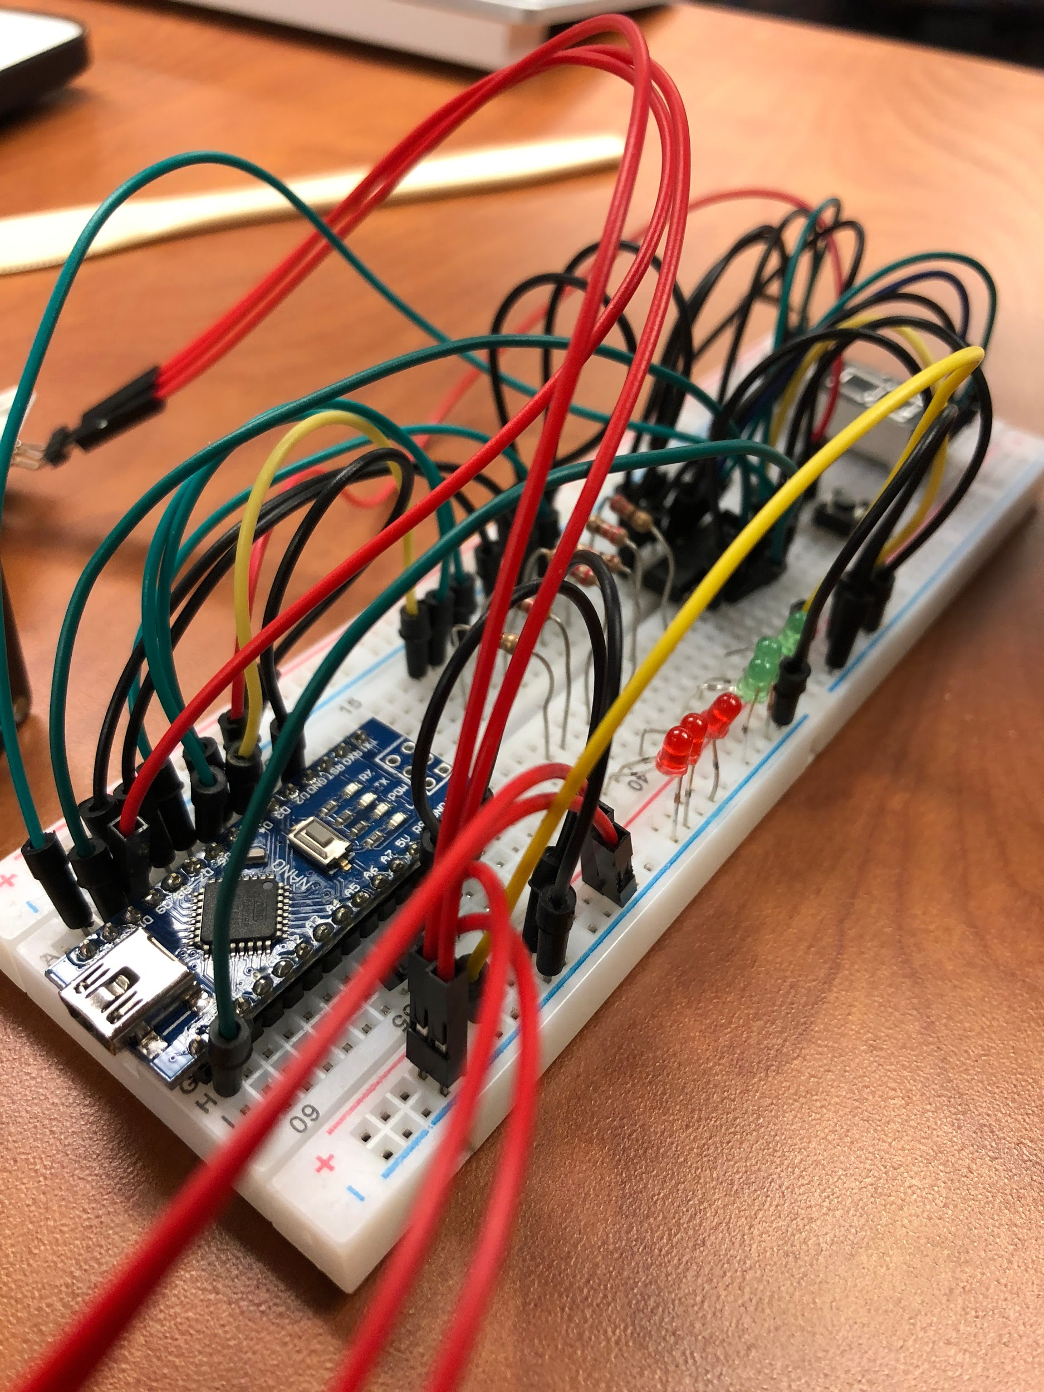
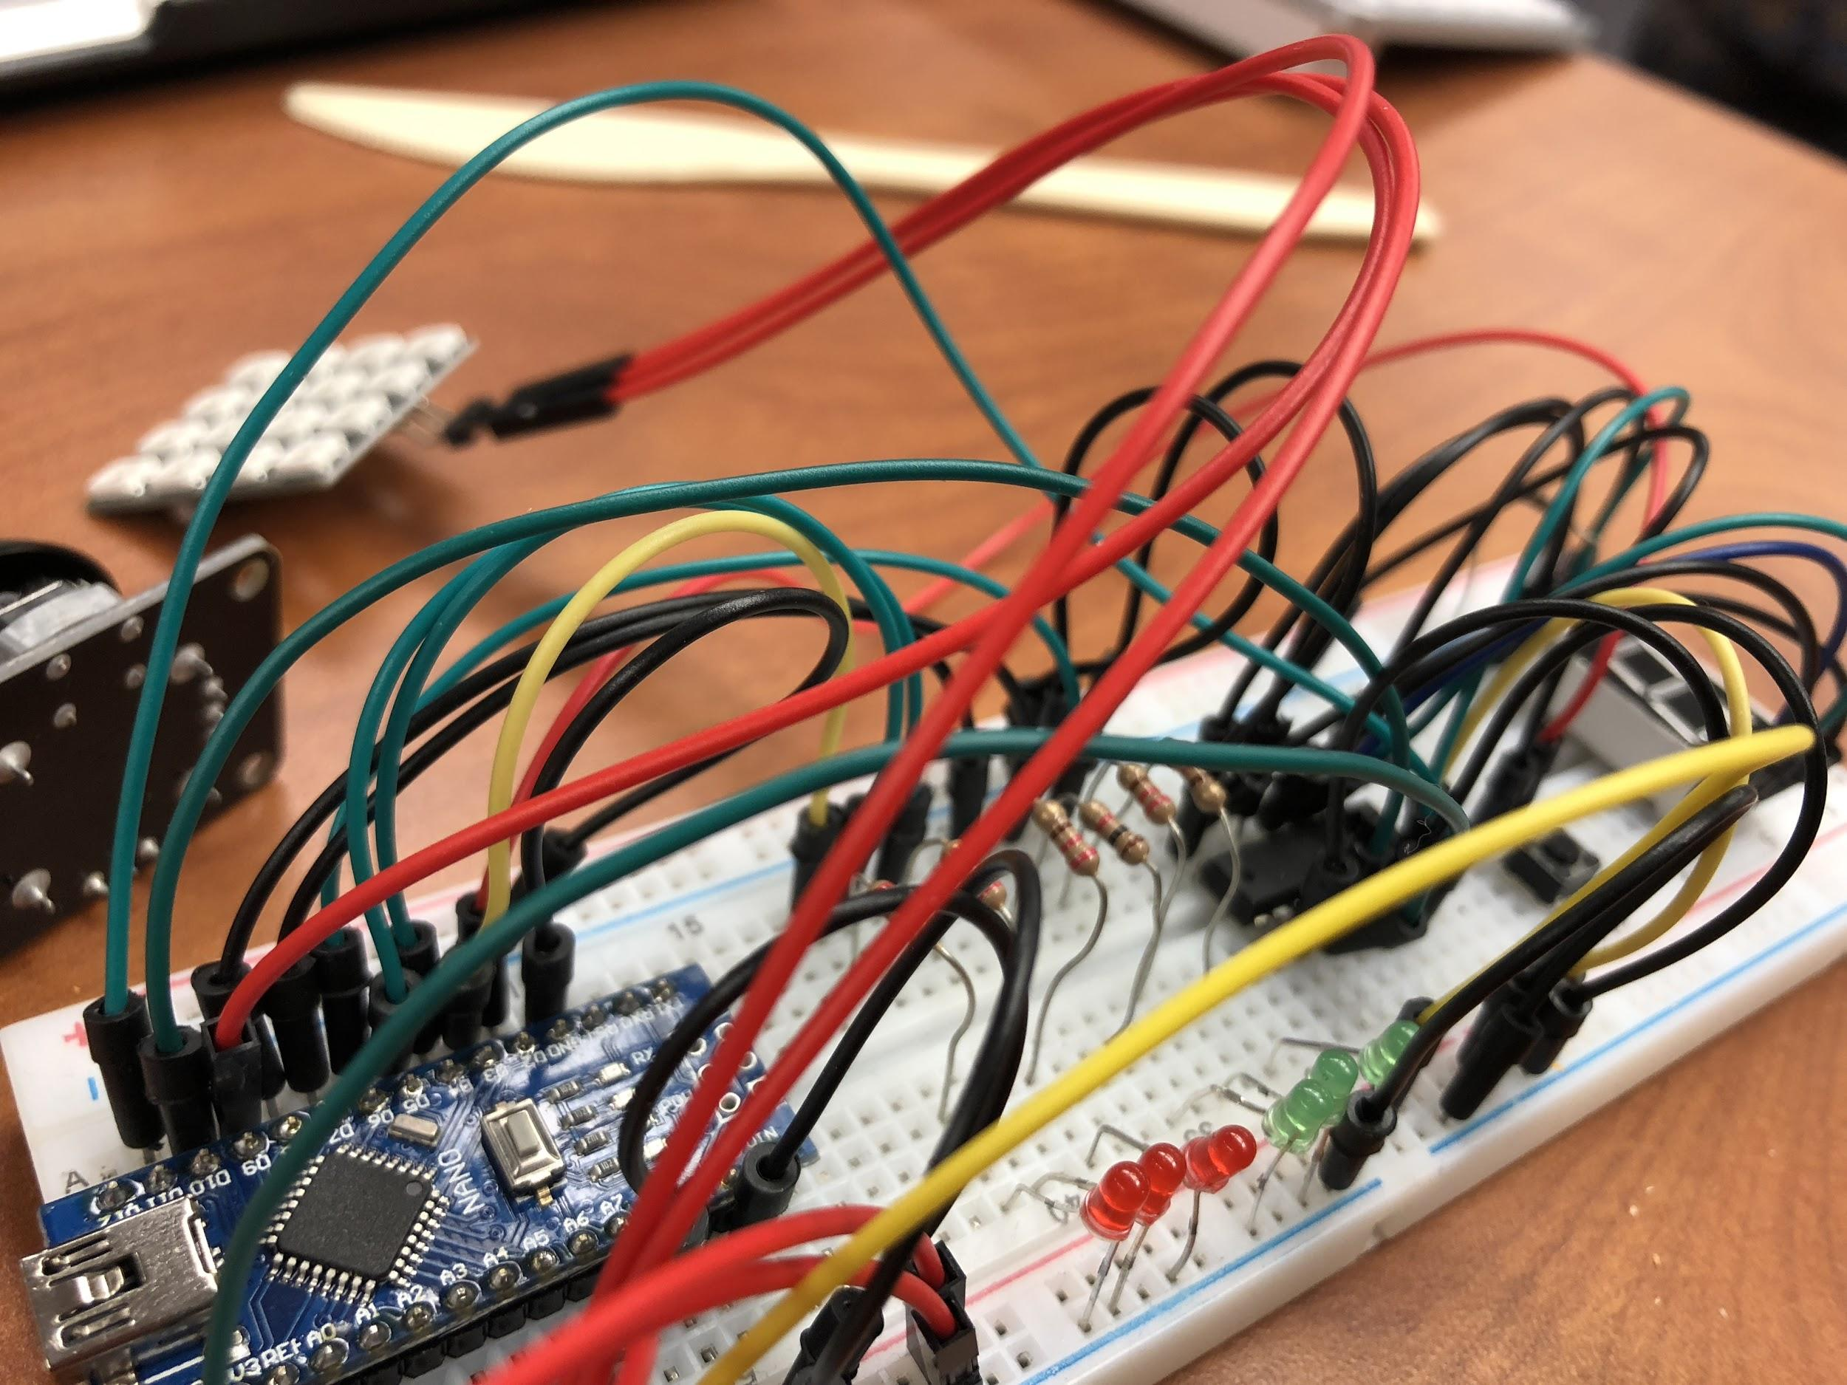

Slide 15
